Slide 1
BRAIN TUMOUR DETECTION USING DEEP LEARNING
FINAL VIVA VOICE
Batch Number:- CBD-15
Under the Supervision of,
Mr. Ramamurthy Ketha
Assistant Professor
School of Computer Science and Engineering
Presidency University
Roll Number:- 20211CBD0054
Student Name:- K. SEETHA THANOOJA
Name of the Program: B.Tech - Computer Science and Technology (Big Data)
Name of the HoD: Pravinthraj S
Name of the Program Project Coordinator: Suma N G
Name of the School Project Coordinators: Dr. Sampath A K / Dr. Abdul Khadar A / Mr. Md Ziaur Rahman

Slide 2
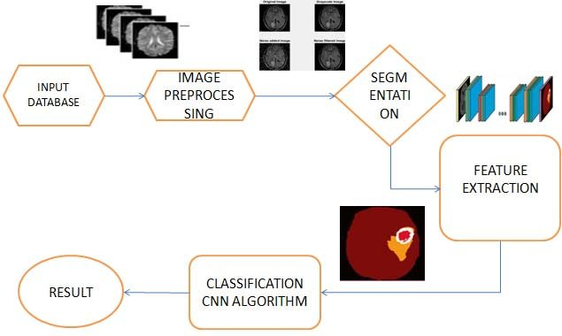
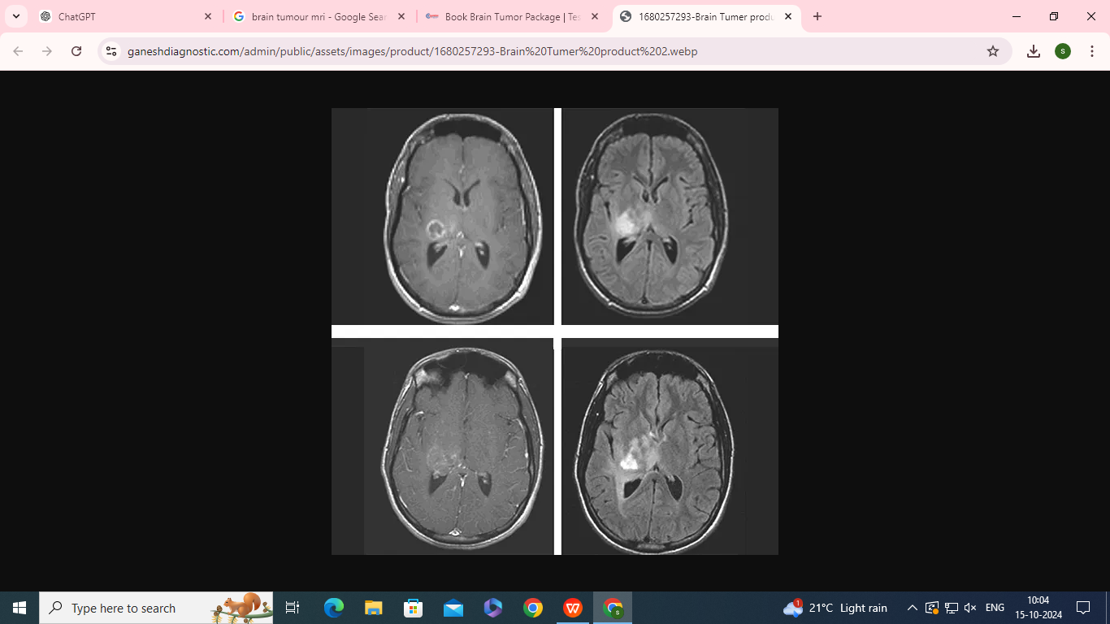
Introduction
Brain tumours are abnormal growths in the brain, which can be malignant (cancerous) or benign (non-cancerous).
Early detection is crucial for effective treatment and improved patient outcomes.
In this project we are using CNNs, so convolutionary neural networks are a type of deep learning model which are particularly effective in image recognition and classification tasks.
CNNs utilize layers of convolutional filters to automatically extract features from images.
We also gather MRI images from publicly available datasets or medical institutions and then normalize these images, resize them to uniform dimensions, and perform data augmentation to enhance model robustness.

Slide 3
Literature Review and Gaps
Introduction:
Brain tumours pose significant challenges in medical diagnostics, necessitating accurate and timely detection to improve patient outcomes. Convolutional Neural Networks (CNNs), a powerful tool in deep learning, have emerged as a promising solution for analyzing medical imaging data, particularly MRI scans.
Key Findings:
Effectiveness of CNNs: Recent studies demonstrate that CNNs significantly enhance the accuracy of brain tumour detection compared to traditional imaging analysis methods.
Methodological Approaches: Various CNN architectures have been explored, including VGG16, ResNet, and Inception. Transfer learning has also gained traction, allowing models pre-trained on large datasets to be fine-tuned for specific tasks.
Challenges: Despite their promise, several challenges persist. These include data scarcity, variability in imaging quality, and the risk of overfitting.
Interpretability: The "black box" nature of CNNs raises concerns about interpretability in clinical settings.

Slide 4
Literature Review (Cont....)
Gaps in the Literature:
There remains a need for research addressing the integration of multimodal data (e.g., combining MRI with genomic information) and the development of real-time diagnostic tools that can assist clinicians during procedures.
Conclusion:
The application of CNNs in brain tumour detection represents a significant advancement in medical imaging. While the existing literature shows promising results, addressing challenges related to data variability and model interpretability will be crucial for successful clinical implementation.
References:
Kharb, P., et al. (2021). "Deep Learning for Glioma Classification." Journal of Medical Imaging.
Murtaza, G., et al. (2020). "Transfer Learning in Medical Image Analysis." IEEE Access.
Raza, S. A., et al. (2022). "Data Augmentation Techniques for Enhancing CNN Performance." Artificial Intelligence in Medicine.
“ This concise survey captures key findings, challenges, and future directions regarding the use of CNNs for brain tumour detection. “

Slide 5
Proposed Methodology
Leveraging the pre-trained model on large image datasets (like Kaggle) and fine-tune them on your brain MRI dataset. This approach helps overcome the issue of limited data.
Transfer Learning
Analyzing which MRI features (e.g., intensity, texture) contribute most to predictions, enhancing model transparency.
Feature Importance Analysis
Establish ongoing communication with healthcare professionals to gather insights and feedback, ensuring the model aligns with clinical needs and practices.
Collaborative
development

Slide 6
Proposed Methodology (Cont....)
Modular Tasks
Data Acquisition Module: Handles downloading and organizing MRI datasets.
Training Module: Implements the training loop, hyperparameter tuning, and validation process.
1
4
Preprocessing Module: Manages normalization and resizing the images.
Evaluation Module: Computes performance metrics and generates evaluation reports.
2
5
Model Architecture Module: Contains the code for defining and building the CNN architecture.
Deployment Module: Manages deployment of the model to a server.
3
6

Slide 7
Objectives
3. Clinical Integration
1. Data Collection
Develop a user-friendly interface for healthcare professionals to facilitate model accessibility and usability.
Collect a comprehensive dataset of MRI images, ensuring diverse tumor types and cases.
Target Objectives
4. Ethical Compliance
2. Data Preprocessing
and Model Design
Ensure adherence to ethical standards and regulatory requirements regarding patient data privacy and security.
Implement preprocessing techniques including normalization, resizing and developing a robust CNN architecture tailored for effective brain tumor classification.

Slide 8
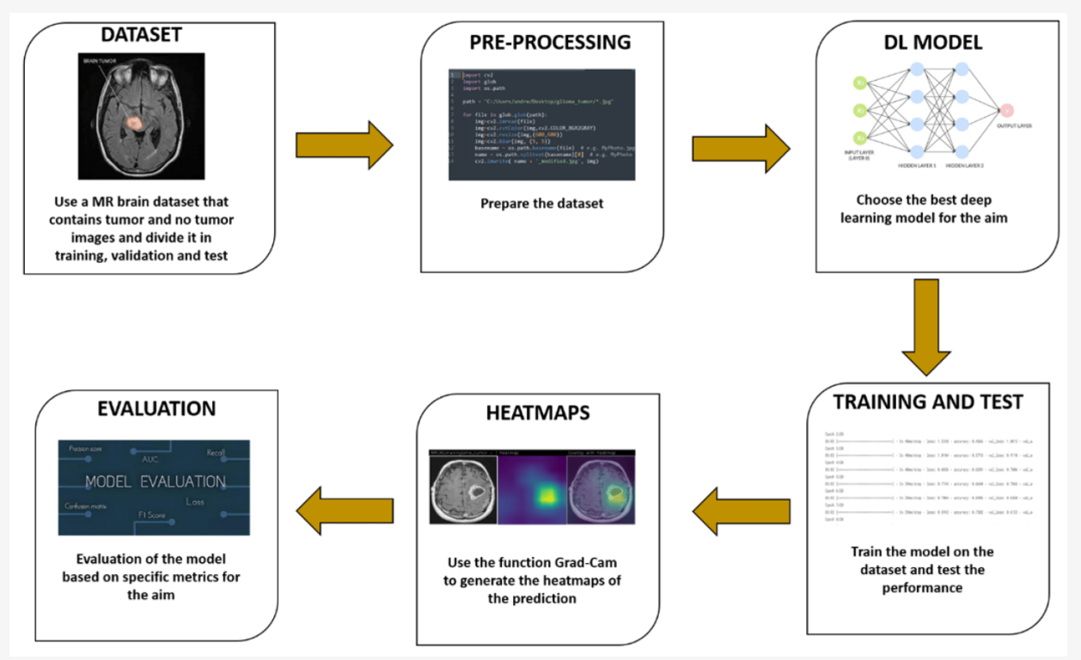
System Design and Architecture

Slide 9
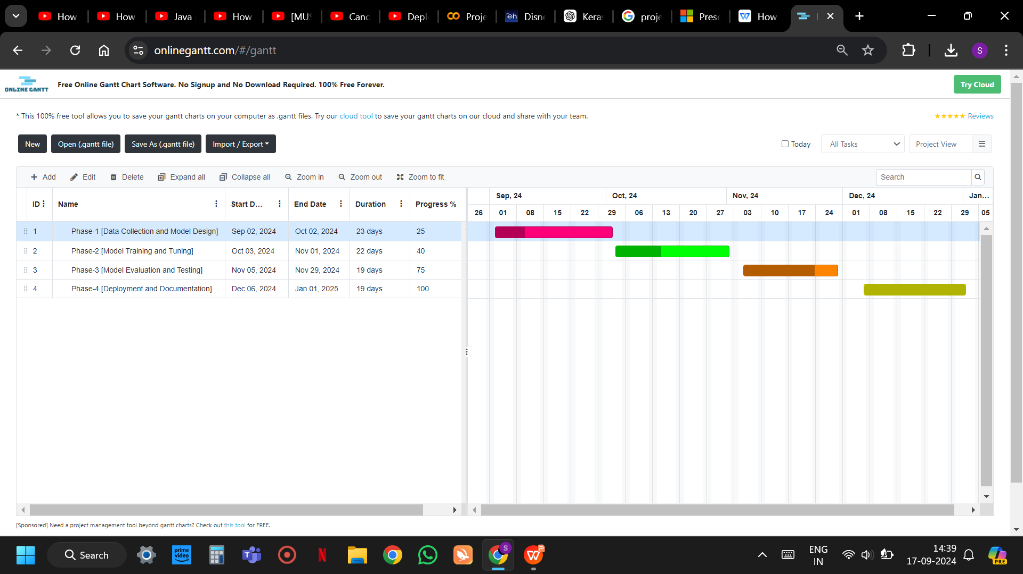
Timeline of the Project
The chart shown below shows a brief description of the project within a stipulated period of time. It explains how the project is divided into sub-modules and then planned and executed as per the deadline.

Slide 10
Expected Outcomes and results...
Improved Diagnostic Accuracy
Early Detection and Diagnosis
Efficiency and Speed in Processing
Reduction in Healthcare Costs
Support for Personalized Treatment Plans

Slide 11
Conclusion
High Accuracy: Deep learning-based models, especially CNNs, demonstrated a significant improvement in the accuracy of brain tumor detection and classification.
Automation: The project successfully automates the tumor detection process, reducing the need for manual intervention and human error.
Faster Diagnosis: The CNN models can analyze large datasets of medical images quickly, allowing for faster diagnosis in clinical settings.
Improved Early Detection: The system aids in detecting tumors at early stages, which is crucial for better patient outcomes.
Reduced Costs: By automating tumor detection, the project helps reduce healthcare costs and improves operational efficiency.
Personalized Medicine: Accurate tumor segmentation supports personalized treatment planning, improving therapy outcomes.

Slide 12
References
https://www.nature.com/articles/s41598-024-52823-9
https://ieeexplore.ieee.org/document/8934561
https://www.researchgate.net/publication/368313790_Brain_Tumor_Detection_and_Classification_using_Intelligence_Techniques_An_Overview
https://bmcmedinformdecismak.biomedcentral.com/articles/10.1186/s12911-023-02114-6
https://aimspress.com/article/doi/10.3934/era.2023146?viewType=HTML
https://www.sciencedirect.com/science/article/pii/S277252862200022X
https://www.mdpi.com/2075-1729/13/7/1449
https://iopscience.iop.org/article/10.1088/1757-899X/771/1/012031
https://www.semanticscholar.org/paper/Brain-Tumor-Detection-Using-Convolutional-Neural-Hossain-Shishir/f89fe7d194c63a62b2cb76fac08ef525b483b964
https://insightsimaging.springeropen.com/articles/10.1186/s13244-020-00869-4

Slide 13
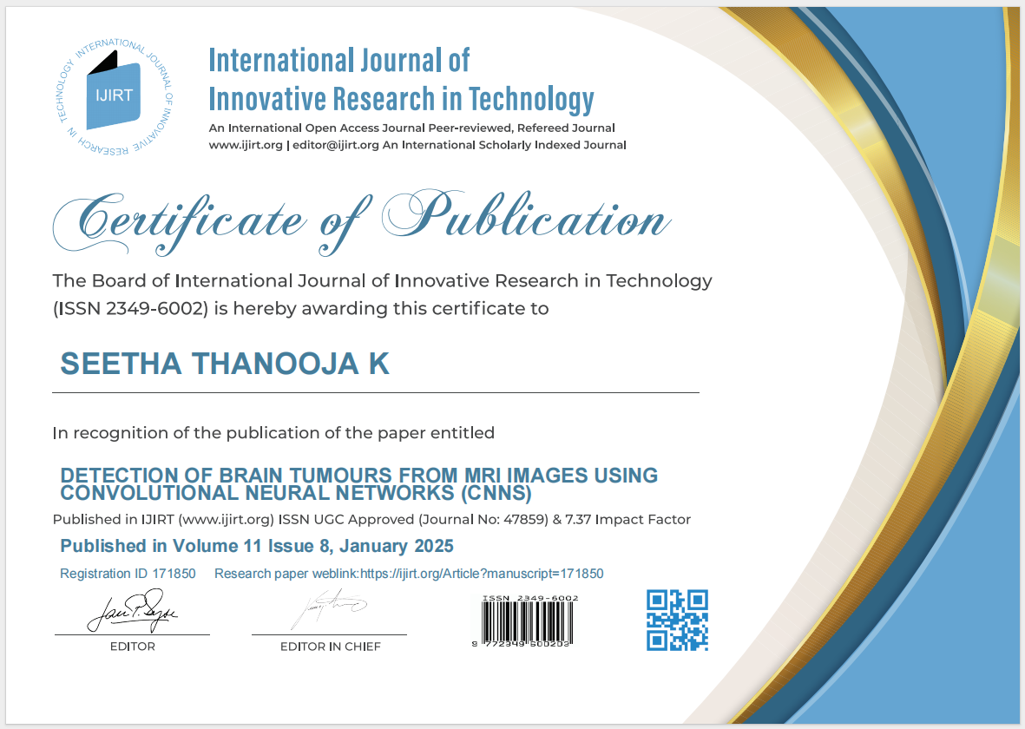
Publication Certificates

Slide 14


Publication Certificates (Cont....)

Slide 15
Thank You

